Slide 1
Design Patterns
Factory patterns
IT 426

Slide 2
The Factory Method Pattern
Leveraging inheritance

Slide 3
Definition: Factory Method
Gang of four
“Define an interface for creating an object, but let subclasses decide which class to instantiate. Factory method lets a class defer instantiation to subclasses.”

Slide 4

When to use the factory method pattern
When a class can’t anticipate the exact object that it needs to solve a problem
When you want to delegate responsibilities to another class. You can let a subclass determine which object is provided.

Slide 5

The Problem
Generating ads in a region
Ads take into account
Languages
Cultural differences
Regional companies
etc…

Slide 6
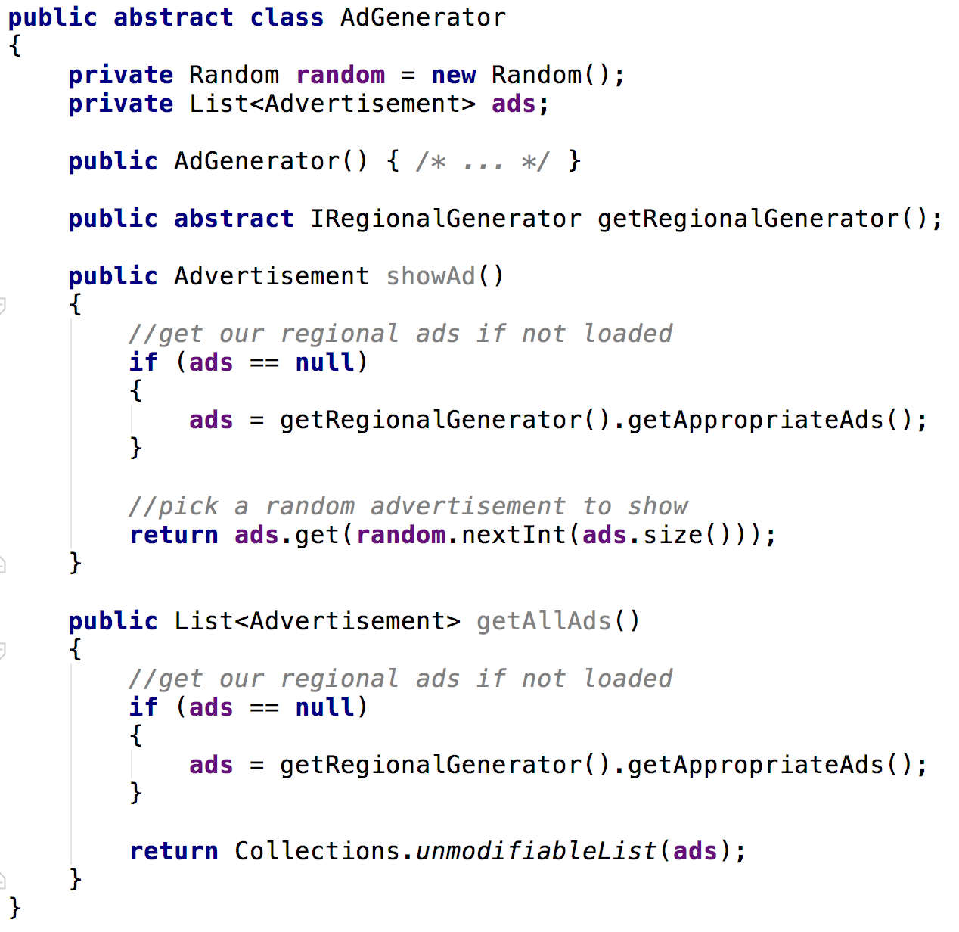
The factory method pattern
Create an ad generating program but keep the implementation abstract
Include an abstract method that provides an object we need to provide advertisements

Slide 7
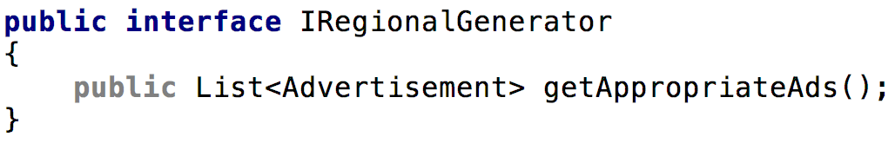
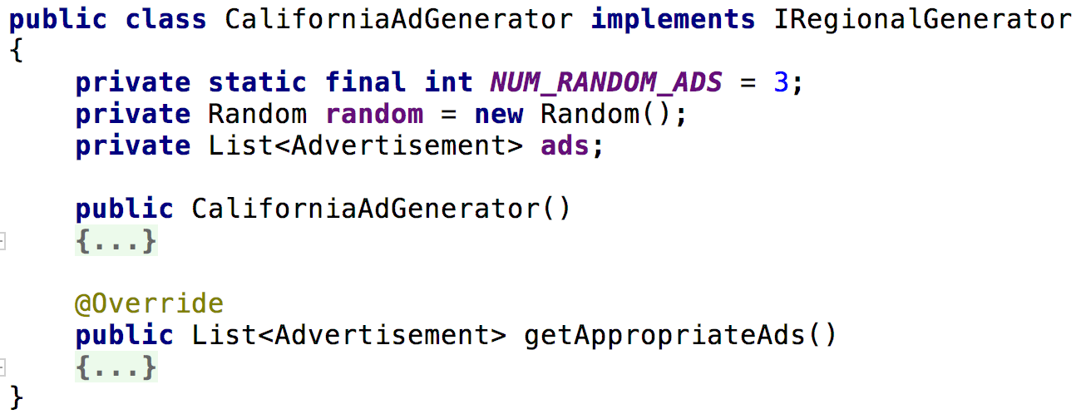
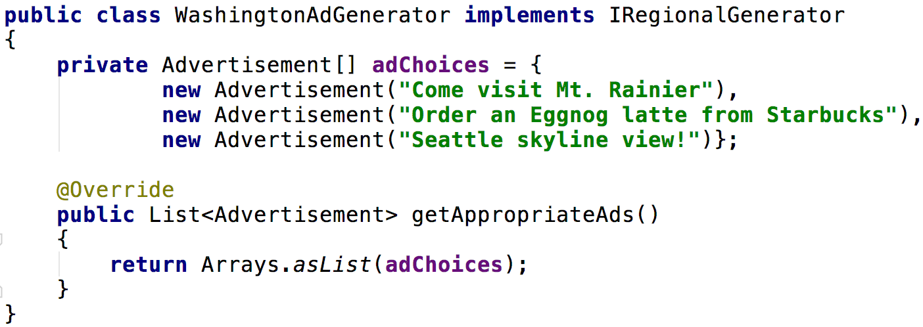
What objects vary?

Slide 8
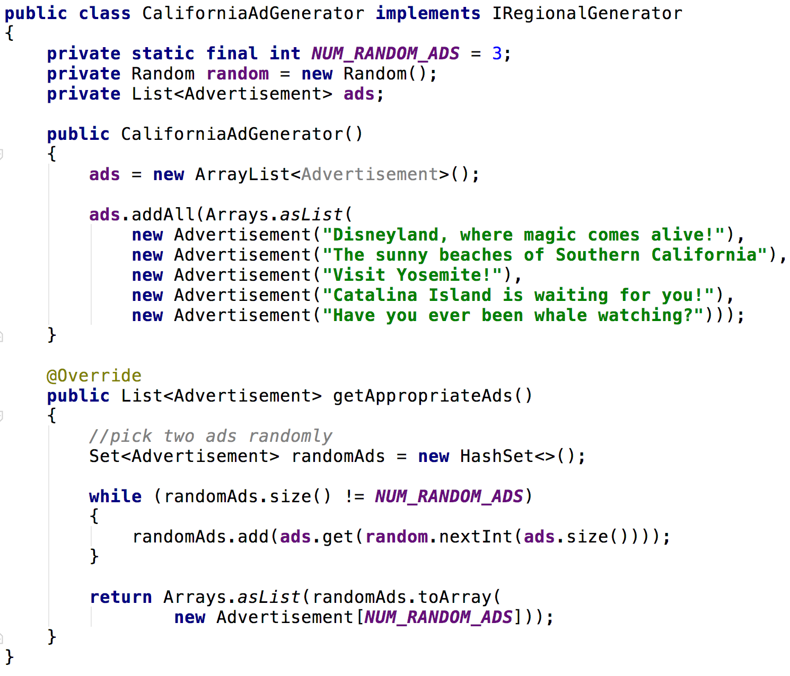
What objects vary?

Slide 9
Our abstract method
We now have the objects to return from our abstract method

Slide 10
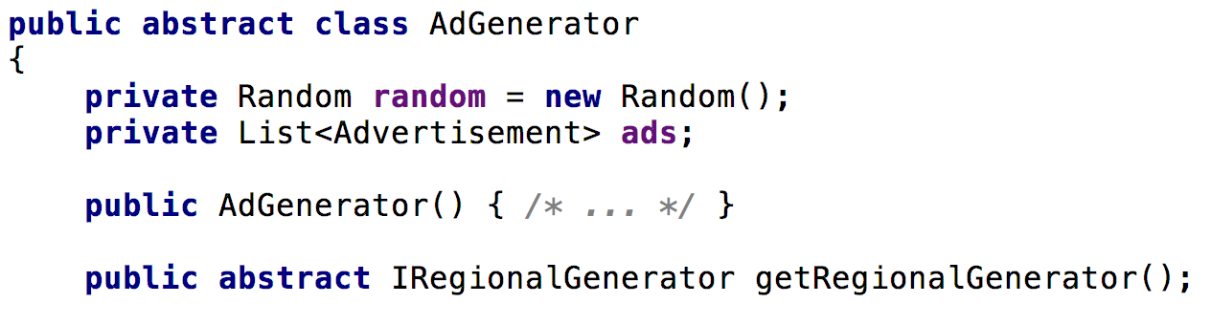
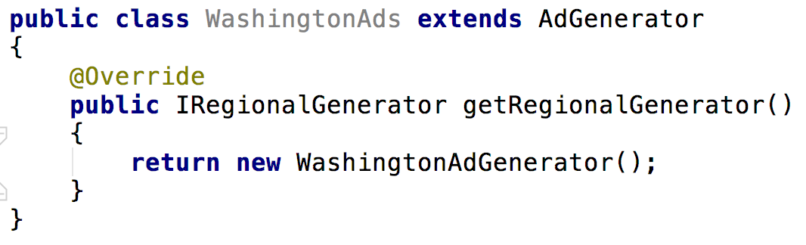
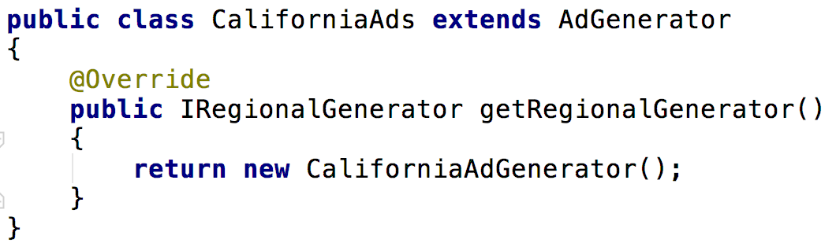
Let subclasses decide what type of object to use

Slide 11
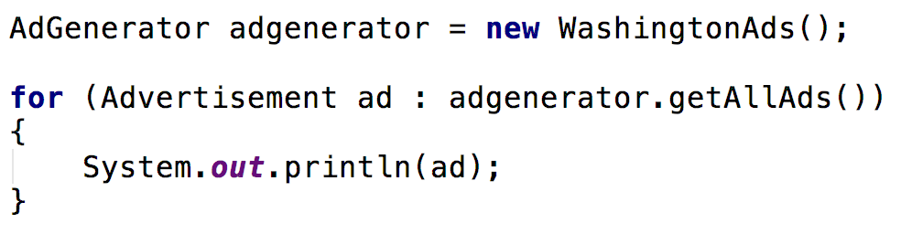
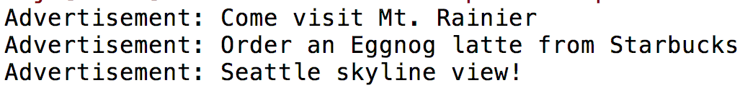
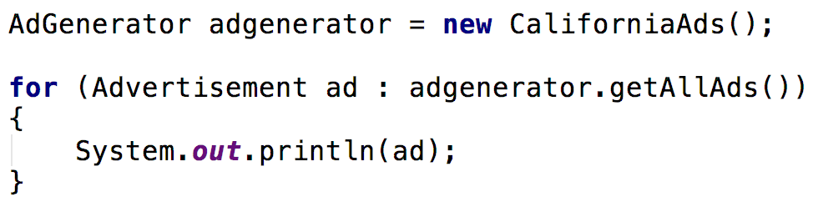
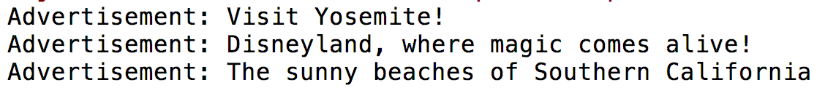
Example output

Slide 12
Factory Methods
The colloquial definition

Slide 13

Colloquial Definition
Methods that return an instance of a class
Usually static
Usually return an instance of the same class they are defined within
Often used in place of overloaded constructors

Slide 14
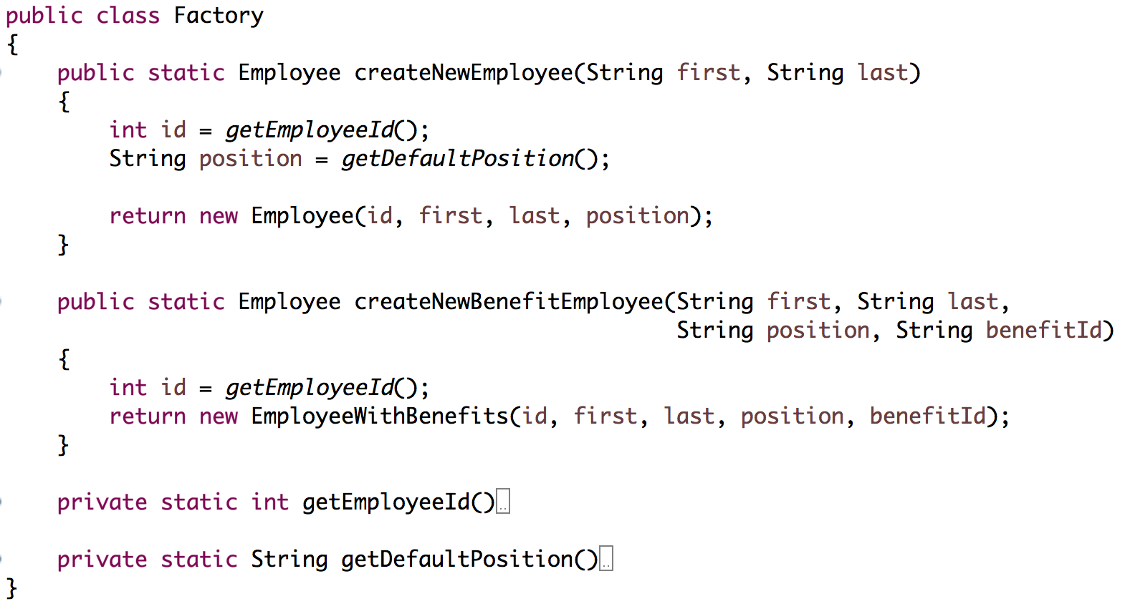
Factory Methods

Slide 15
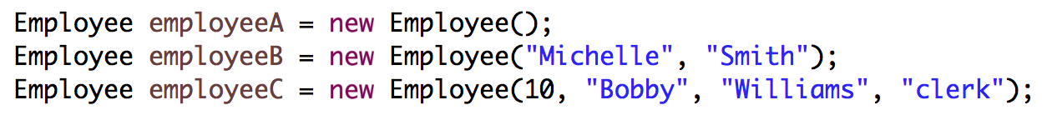
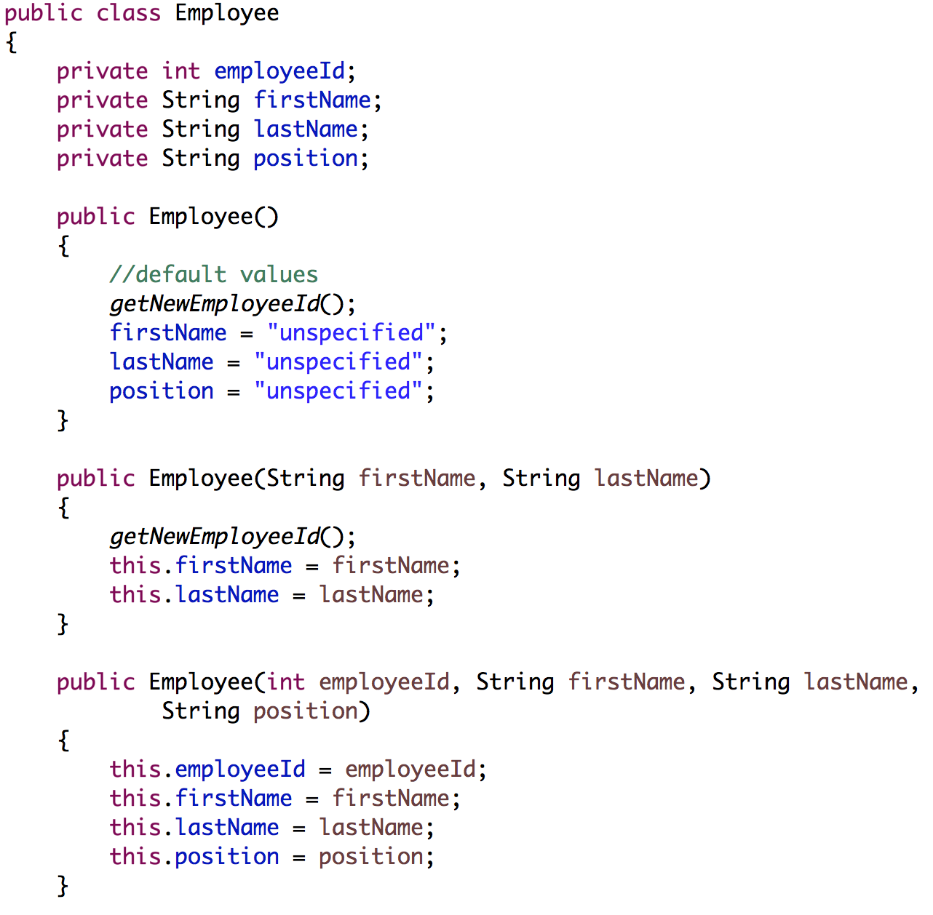
Using overloaded constructors
Is this readable?

Slide 16
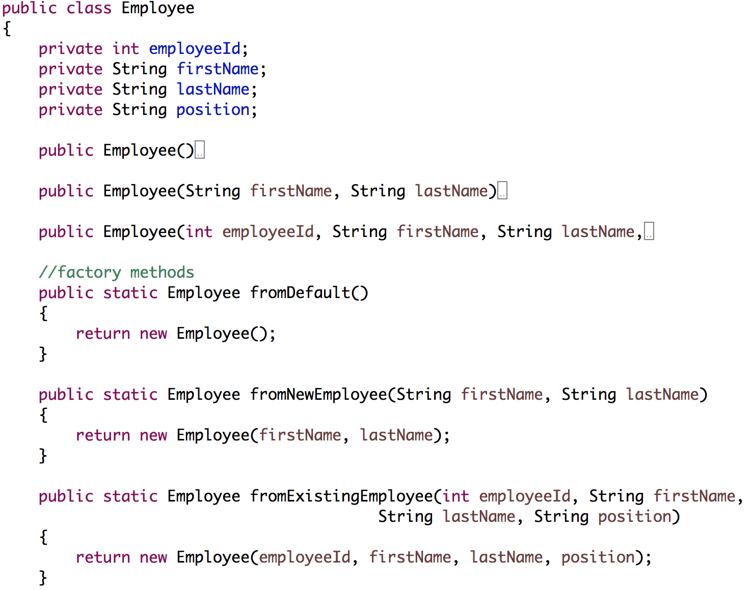
Using factory methods in place of constructors
Is this readable?

Slide 17
The Abstract Factory Pattern
Groups of objects creating objects

Slide 18
Definition: Abstract Factory
Gang of four
“Provides an interface for creating families of related or dependent objects without specifying their concrete classes.”

Slide 19
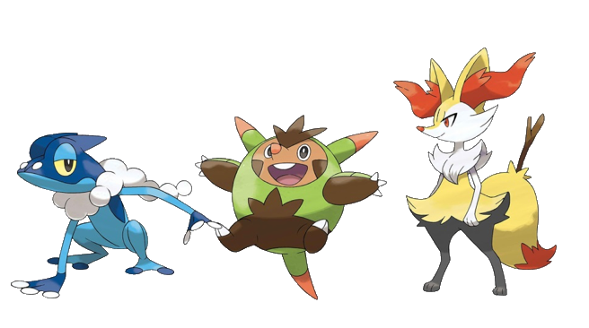
Interacting with animals
Create a program that allows you to interact with digital animals
Pokemon animals, Zoo animals, etc…
and their caretakers:
Pokemon trainers, Zoo employees, etc…

Slide 20
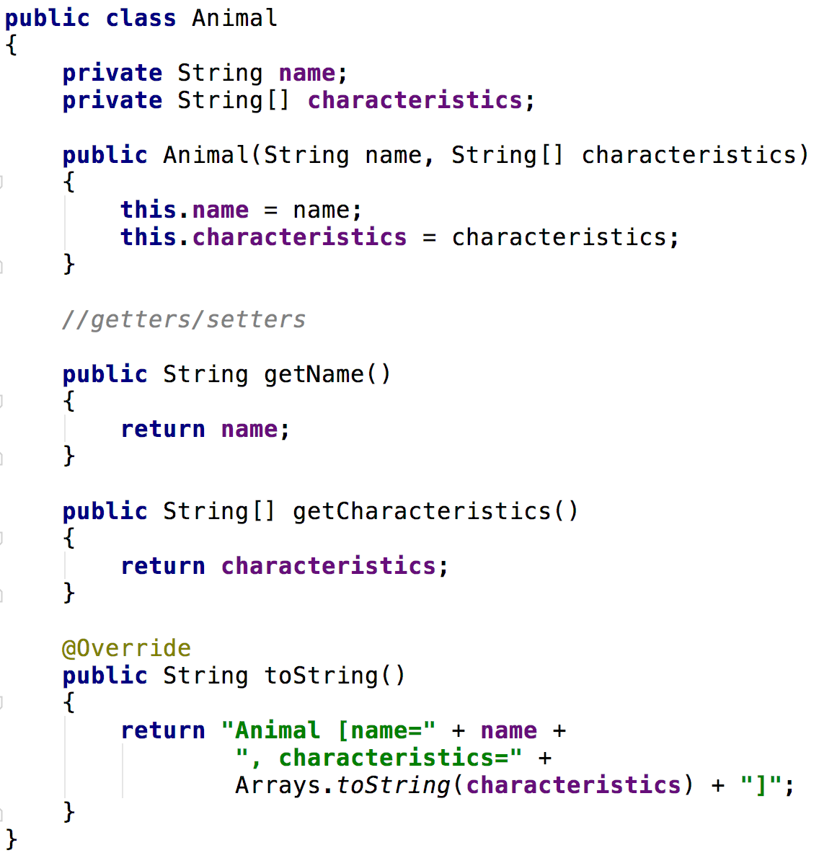
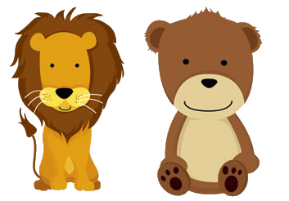
Entity classes

Slide 21
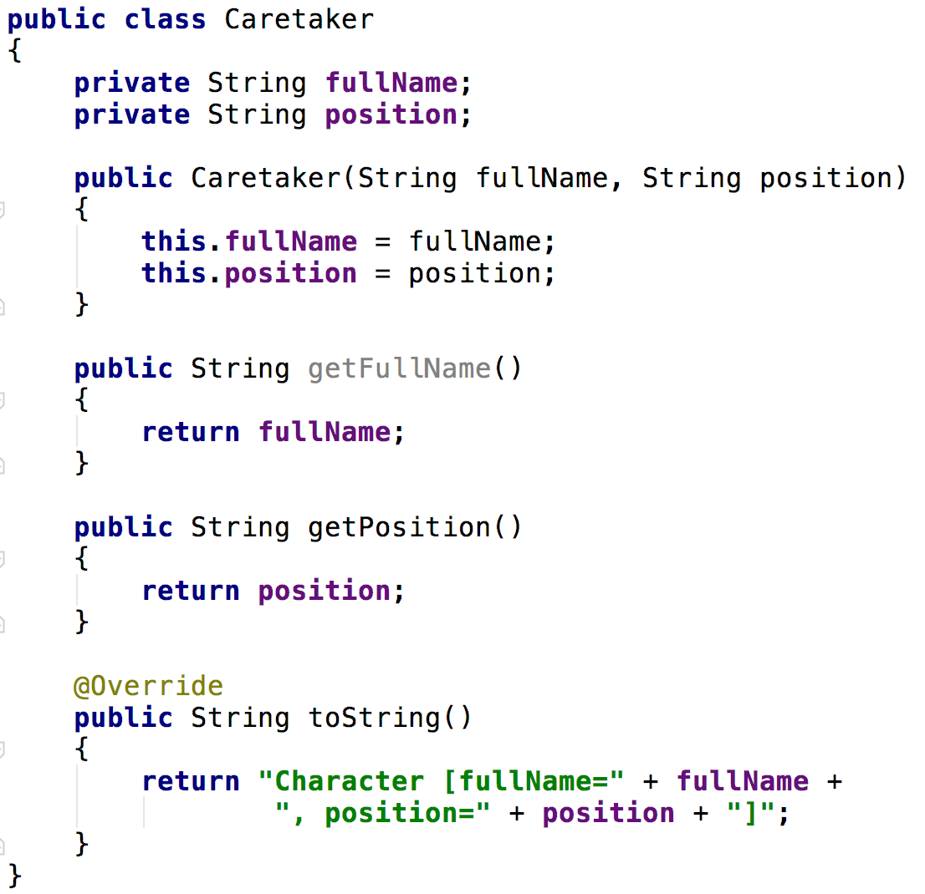

Entity classes

Slide 22
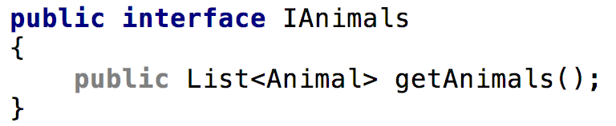
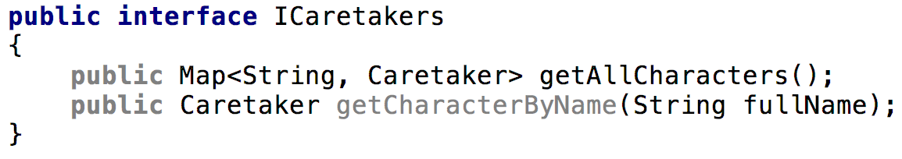
Identify our data classes
I should have classes that retrieve groups of animals or caretakers
I should be able to pick different types of animals or caretakers

Slide 23
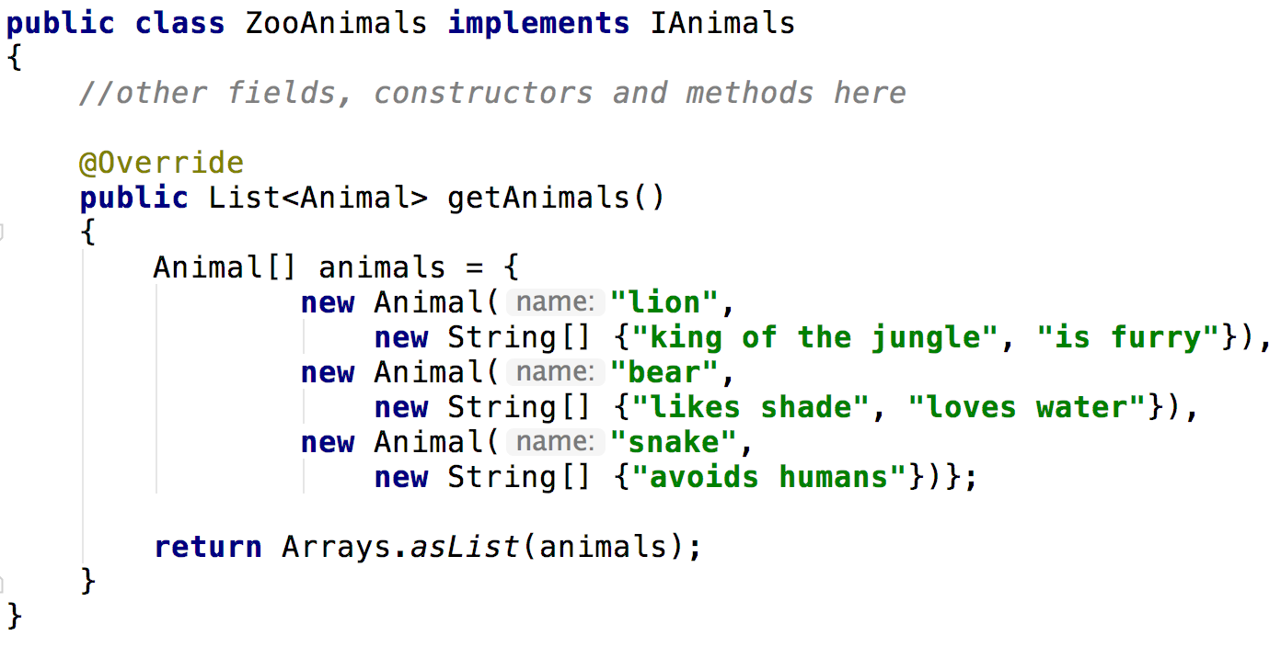
Data class implementations

Slide 24
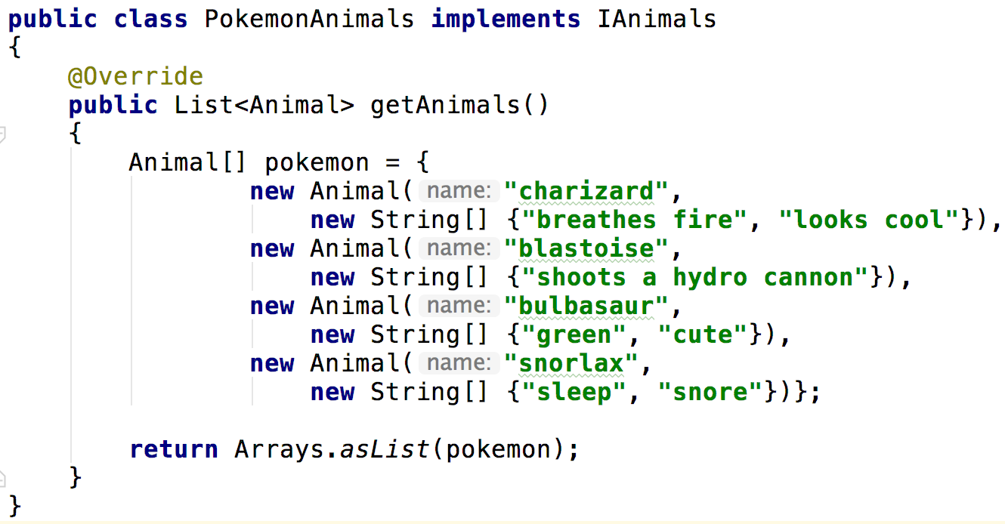
Data class implementations

Slide 25
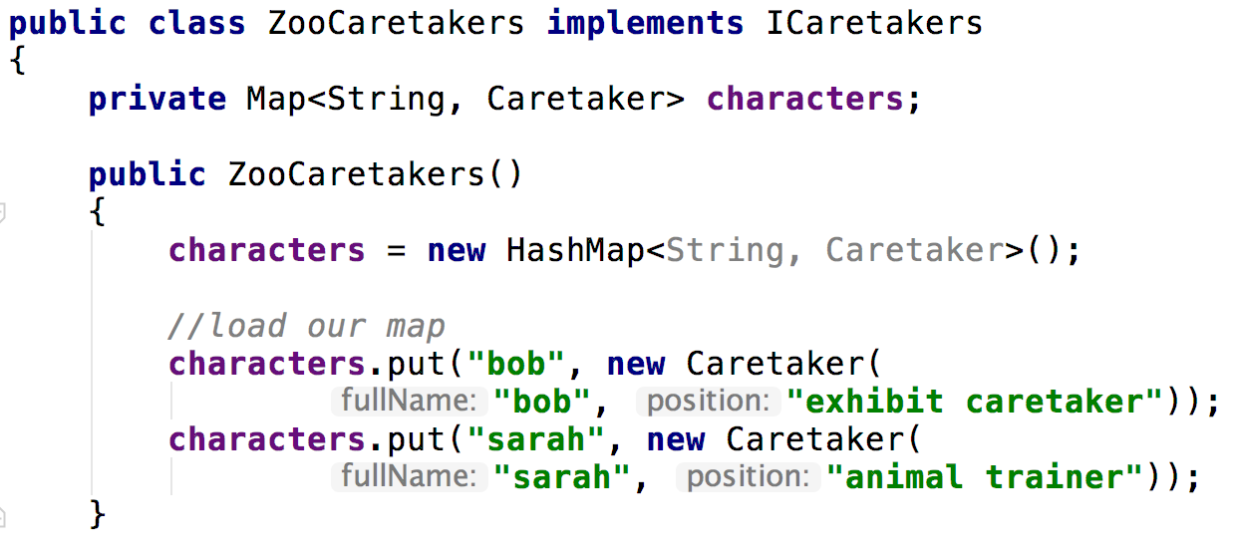
Data class implementations

Slide 26
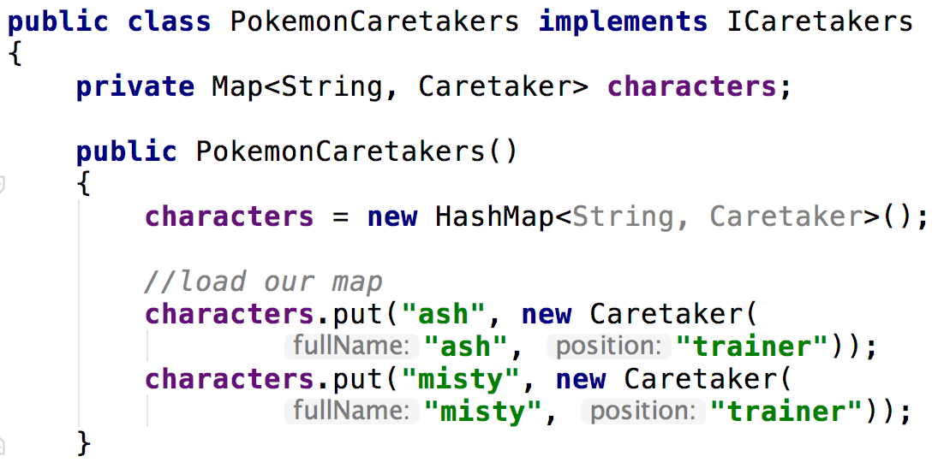
Data class implementations

Slide 27
Importance of interfaces
These data classes should be programmed against interfaces so they can be swapped out as needed
I should be able to make the following change easily
IAnimals animals = new PokemonAnimals(); animals = new ZooAnimals();
The similarities in the previously seen classes are a large simplification. Typically you would see vastly different implementations, even with the matching interface.

Slide 28
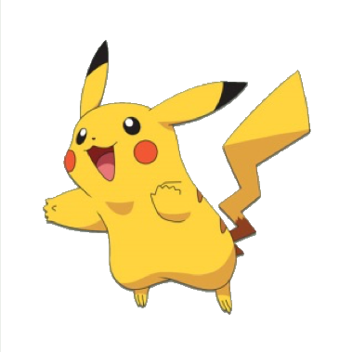
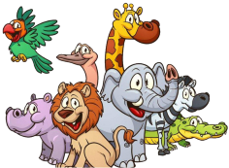
Families of objects
Zoo
Pokemon
Zoo animals
Zoo caretakers
Pokemon animals
Pokemon caretakers
The abstract factory contains families of objects that together solve a problem

Slide 29
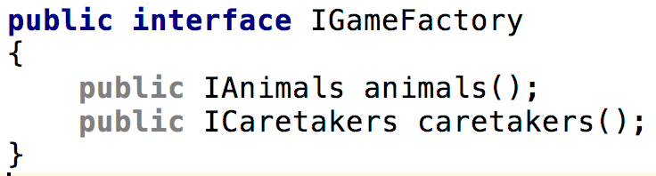
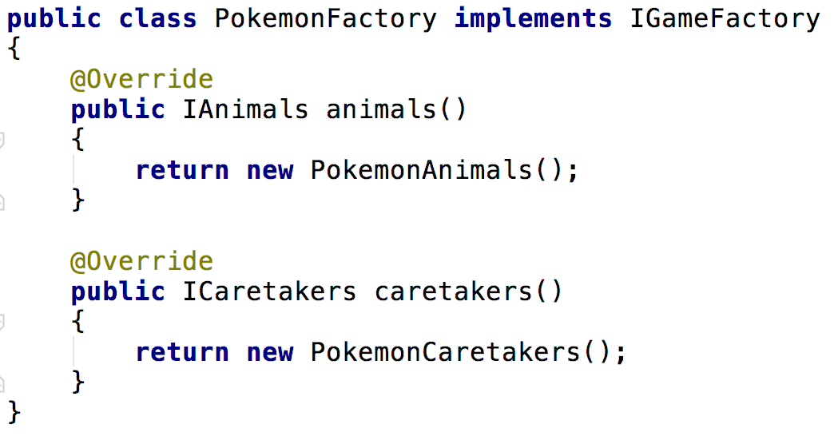
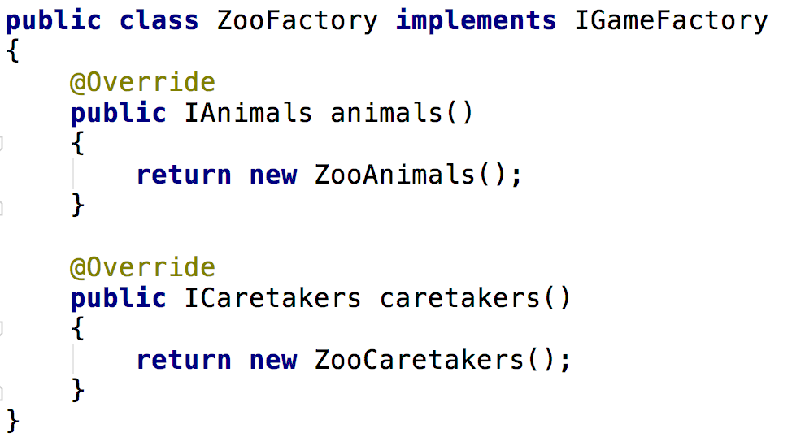
The Abstract Factory
Abstract factory interface
Abstract factory implementations

Slide 30
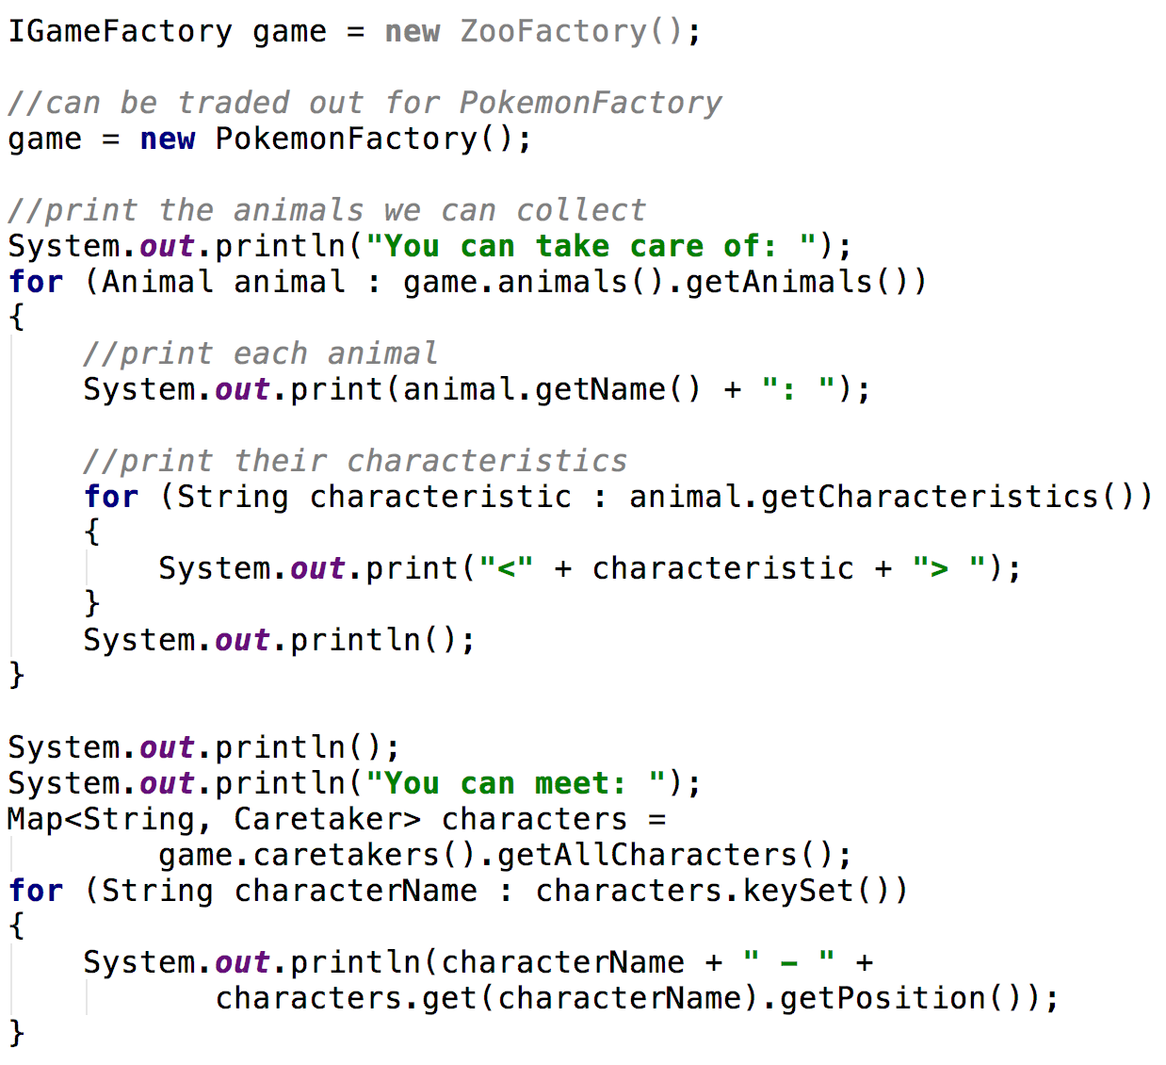
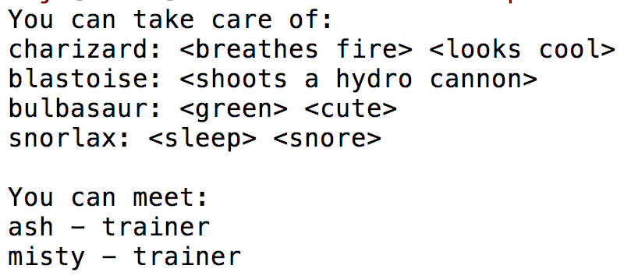
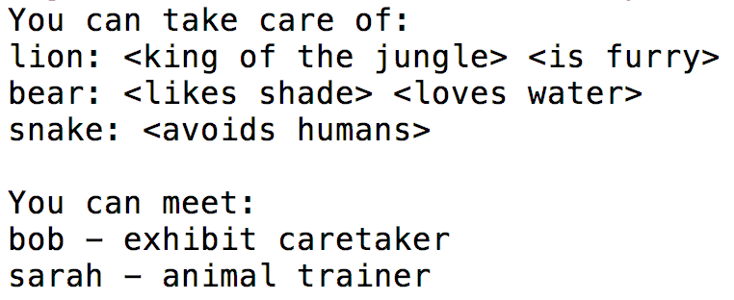
Dynamic change

Slide 31
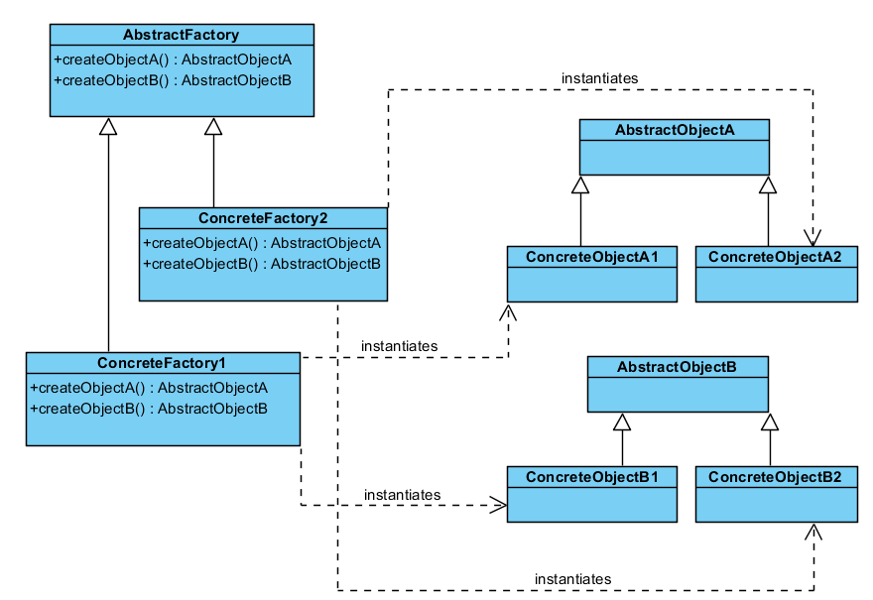
Questions?

Slide 32
Sources
Gamma, Erich, et al. Design Patterns: Elements of Reusable Object-Oriented Software. Indianapolis, IN: Addison-Wesley, 1994

Slide 33
Design Patterns
Factory Patterns
IT 426

